Slide 1


Information Security
Lecture 3
D R . Muhammad Umar Aftab
NATIONAL UNIVERSITY OF COMPUTER & EMERGING SCIENCES

Slide 2

MOTIVATION
Cryptography is an essential component of cyber security.
The need to protect sensitive information and ensure the integrity of industrial control processes has placed a premium on cyber security skills in today’s information technology market.
Demand for cyber security jobs is expected to rise 6 million globally by 2019, with a projected shortfall of 1.5 million, according to Symantec, the world’s largest security software vendor.
According to Forbes, the cyber security market is expected to grow from $75 billion in 2015 to $170 billion by 2020.

Slide 3
TODAY’S LECTURE
Block Ciphers
  Data Encryption Standard (DES)
    DES Encryption / Decryption
    Strength of DES
    Weakness of DES
  Multiple DES Encryption
  Double DES
  Meet-in-the Middle Attack
  Triple DES
  Advance Encryption Standard (AES)

Slide 4
DES WEAKNESS
DES is vulnerable to brute force attack due to small key size
2⁵⁶ = 72,057,594,037,927,936 The number of different possible keys in the obsolete 56 bit DES symmetric cipher.
Alternative block cipher that makes use of DES software/equipment/knowledge: encrypt multiple times with different keys options:
  Double DES
  Triple DES

Slide 5
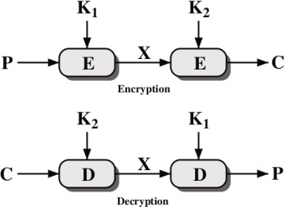
DOUBLE DES
For DES, 2 × 56-bit keys, meaning 112-bit key length
Meet-in-the-middle attack makes it easier

Slide 6
MEET-IN-THE-MIDDLE ATTACK
Double DES Encryption: C = E(K2; E(K1; P))
Say E(K1; P) = X = D(K2; C)
  Attacker knows two plaintext, ciphertext pairs (Pa; Ca) and (Pb; Cb) Encrypt Pa using all 256 values of K1 to get multiple values of X
  Store results in table and sort by X
  Decrypt Ca using all 2⁵⁶ values of K2
  As each decryption result produced, check against table
  If match, check current K1; K2 on Cb. If Pb obtained, then accept the keys
With two known plaintext, ciphertext pairs, probability of successful attack is almost 1
Encrypt/decrypt operations required: 2⁵⁶ (twice as many as single DES)

Slide 7
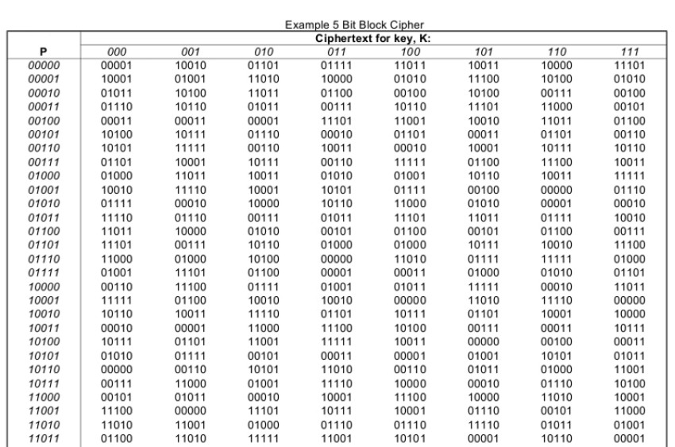
EXAMPLE: MEET-IN-THE-MIDDLE ATTACK

Slide 8
TRIPLE DES (3DES)
We saw that Double-DES has a key length of 112 bits, but meet-in-the-middle attack against Double-DES reduces its work factor to about the same as DES. Thus, it is no more secure than DES. So let’s move on to 3DES.

Slide 9
3DES PERFORMANCE
3DES uses 48 rounds in its computation, which makes it highly resistant to differential cryptanalysis. However, because of the extra work 3DES performs, there is a heavy performance hit. It can take up to three times longer than DES to perform encryption and decryption.

Slide 10
3DES MODES
DES-EEE3 Uses three different keys for encryption, and the data are encrypted, encrypted, encrypted
DES-EDE3 Uses three different keys for encryption, and the data are encrypted, decrypted, and encrypted
DES-EEE2 The same as DES-EEE3 but uses only two keys, and the first and third encryption processes use the same key
DES-EDE2 The same as DES-EDE3 but uses only two keys, and the first and third encryption processes use the same key

Slide 11
ADVANCED ENCRYPTION STANDARD (AES)
After DES was used as an encryption standard for over 20 years and it was cracked in a relatively short time once the necessary technology was available, NIST decided a new standard, the Advanced Encryption Standard (AES), needed to be put into place.

Slide 12
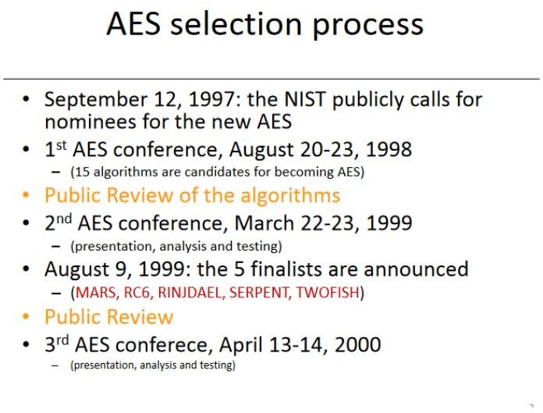
AES Selection Process
Notes:
NIST announced for a successor of DES because DEC become vulnerable to bruteforce attack.
DEC cracked by super computer at that time.

Slide 13
AES
Rijndael chosen, standard called AES created in 2001
AES:
  Symmetric key symmetric block cipher
  Block size: 128 bits (others possible)
Key size: 128, 192, 256 bits
  Rounds: 10, 12, 14 (depending on key)
  Operations: XOR with round key, substitutions using S-Boxes, mixing using Galois Field arithmetic
  Widely used in file encryption, network communications
  Generally considered secure

Slide 14
AES
AES:
  Stronger and faster than Triple-DES and six time faster.
  Widely adopted symmetric encryption algorithm
  AES based Rijndael cipher developed by two Belgian cryptographers; Vincent Rijmen and Joan Daemen.

Slide 15
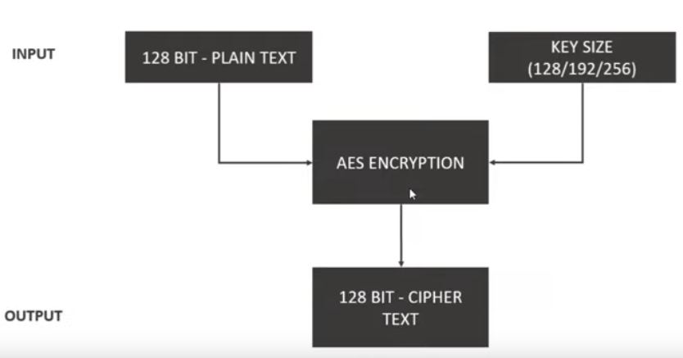
AES Working Mechanism

Slide 16
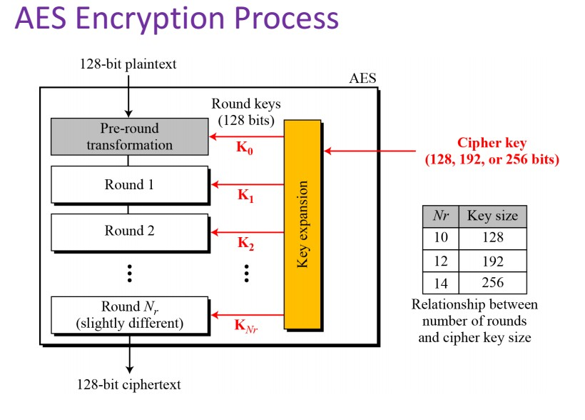
AES Encryption Process
Notes:
Key size= 10 → Round = 11 (10 + 1[zero round])
Starting Key = K0 → generate other keys

Slide 17
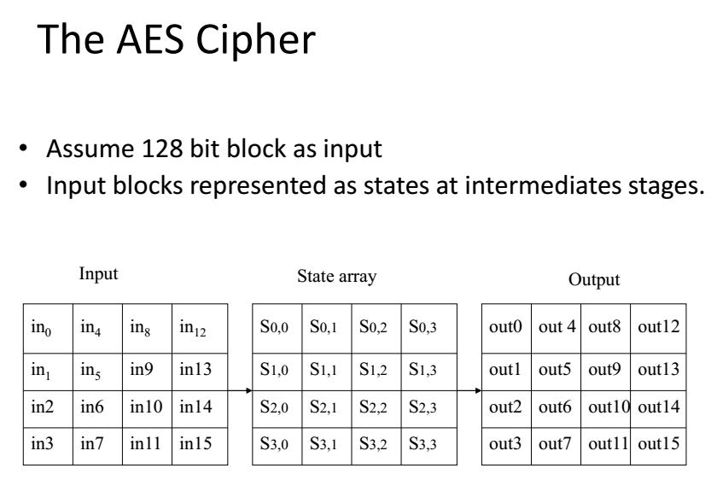
The AES Cipher

Slide 18
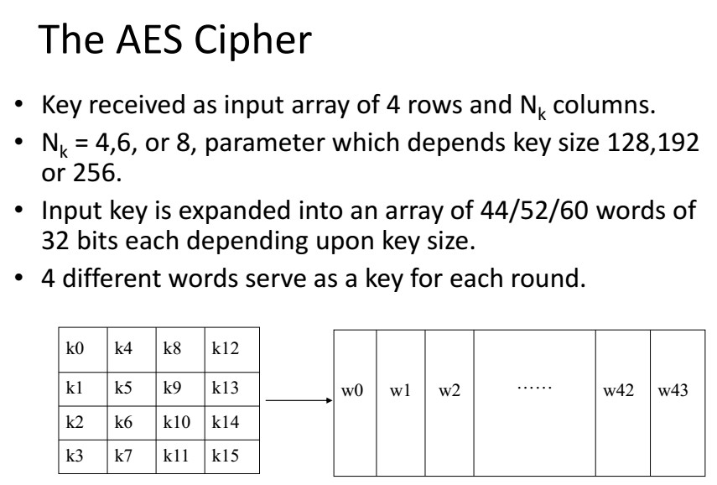
The AES Cipher

Slide 19
Process In AES
There are two steps in AES: Key Generation & Rounds
Key Generation:
  ROT word of last Column
  Sub Byte of ROT word
  XOR with RCON and First Column of key and Sub-byte
  Result become first column of round key one
Round:
Initial Round | Main Round | Final Round
XOR with round key 0 | Sub byte Shift rows Mix Columns Add round key | Sub byte Shift rows Add round key

Slide 20
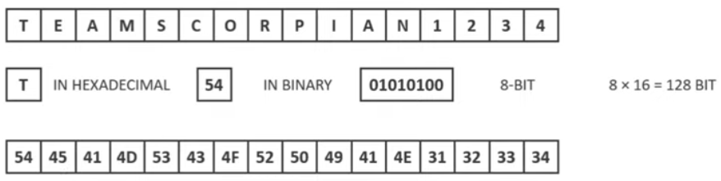
Key Generation
128-bit Key: TEAMSCORPIAN1234
Notes:
A=41 & Z=5A
0= 30 & 9=39

Slide 21
Key Generation
128-bit Key: TEAMSCORPIAN1234
Every single column is a byte as well: 8bits = 1 Byte

Slide 22
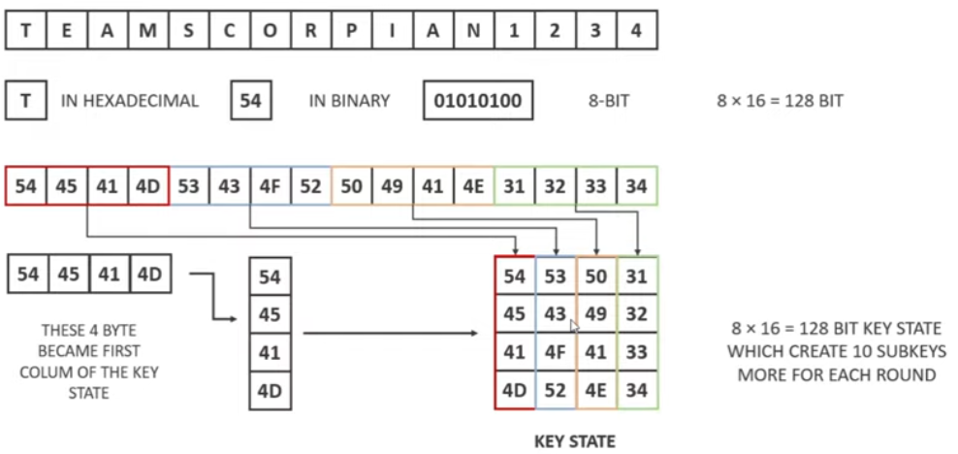
Key Generation
Notes:
We create a cube from the data.
So we get our key sate and generate other keys

Slide 23
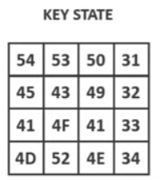
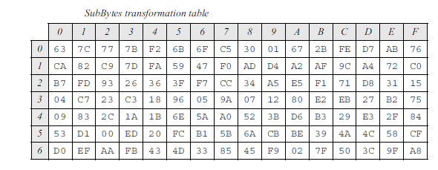
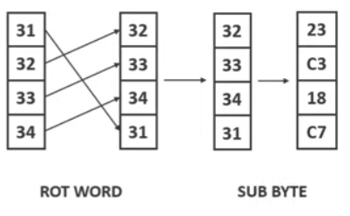
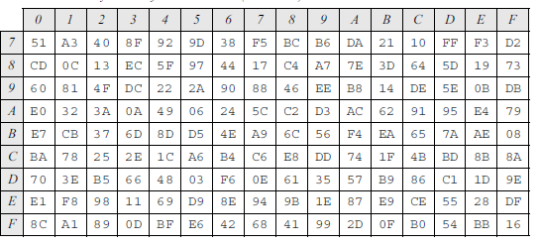
Sub-Key Generation from Key State
Notes:
So we get our key sate and generate other keys

Slide 24
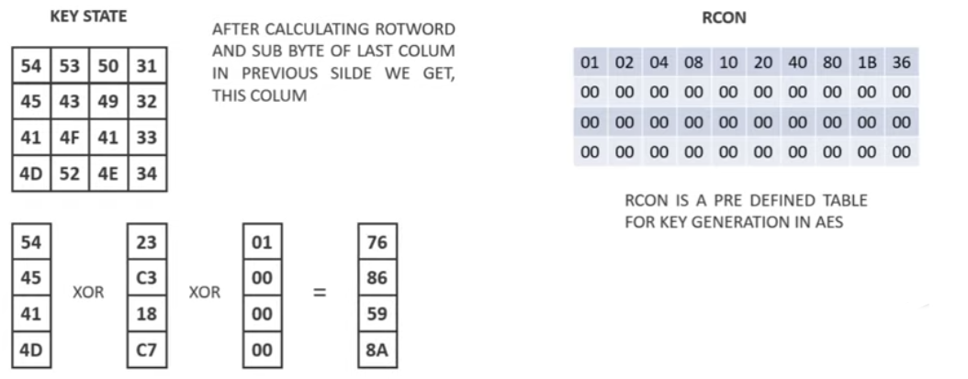
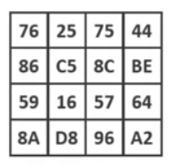
Sub-Key Generation from Key State
Notes:
Now Take XOR with every column & first computed column.
Key state became key 0, & Key 1 we get in this slide. → key 1 create key 2 & so on

Slide 25
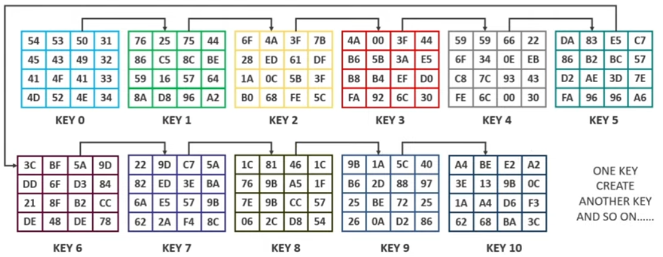
Sub-Keys

Slide 26
Encryption Process
Three types of rounds:
  Initial Round
  Main Round
  Final Round

Slide 27
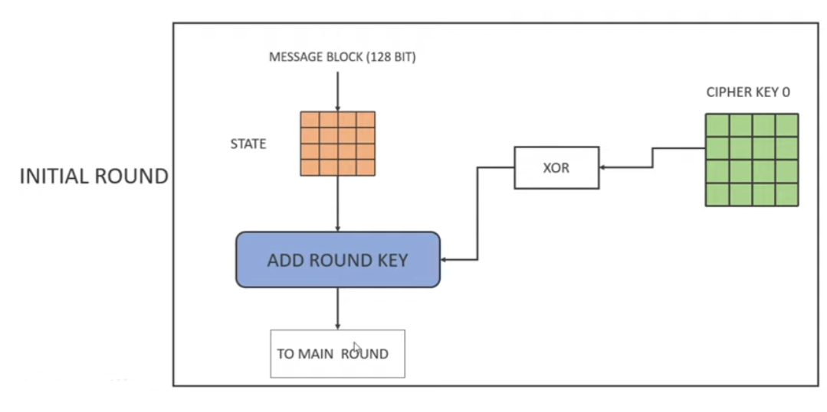
Encryption Process
Notes:
In this round, simply Key 0 XOR with message state.

Slide 28
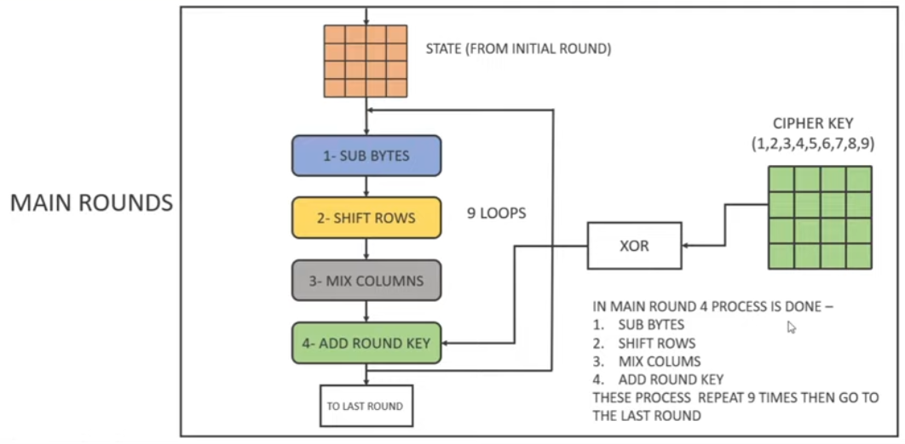
Encryption Process

Slide 29
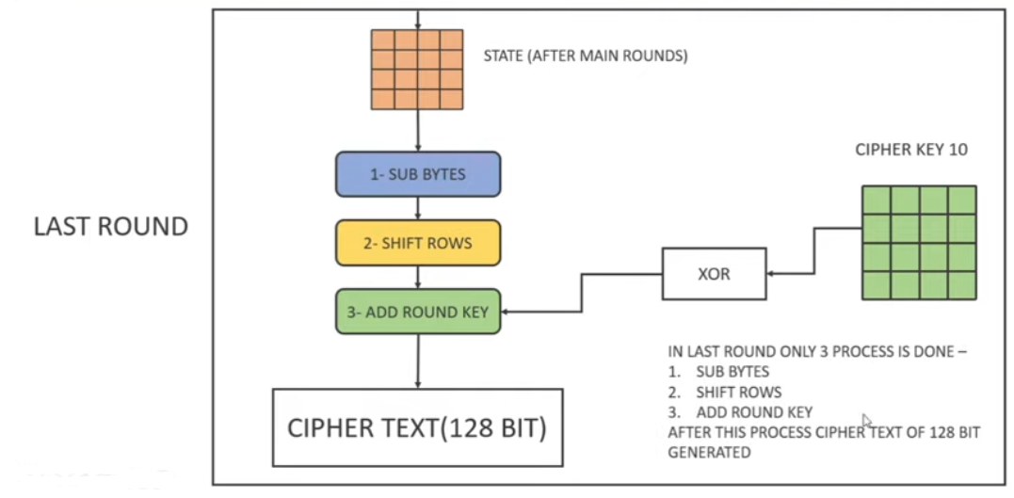
Encryption Process

Slide 30
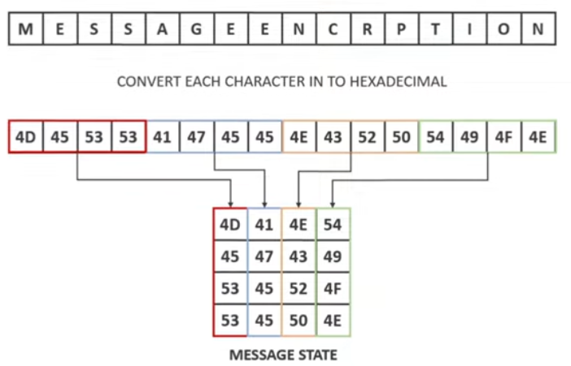
Message Conversion into State
128-bit (16 Byte) Message :- MESSAGEENCRPTION

Slide 31
Round Steps
There are four steps in each round-
  Add round key
  Sub Bytes
  Shift Rows
  Mix Columns

Slide 32
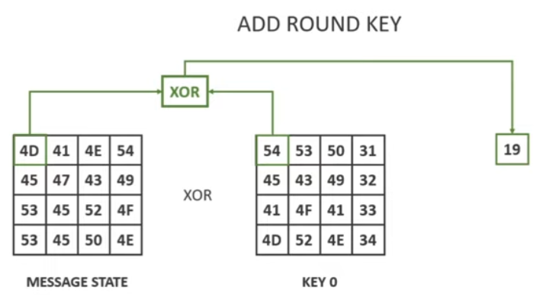
Round Steps

Slide 33
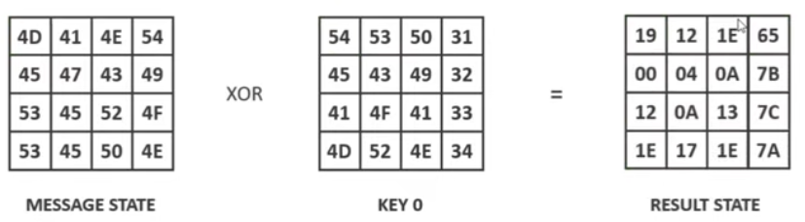
Round Steps: Add round key

Slide 34
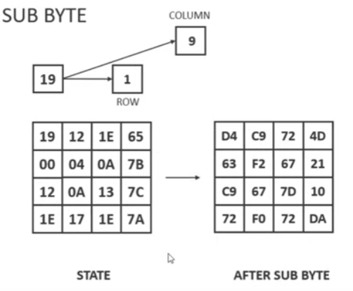
Round Steps: Sub Byte

Slide 35
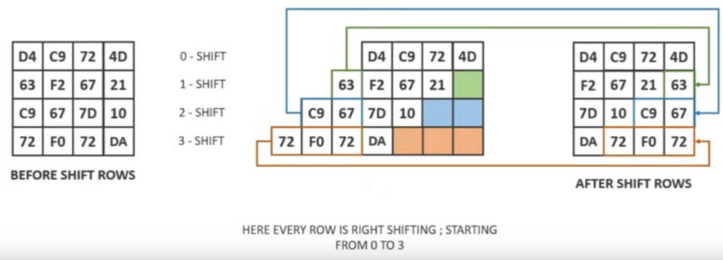
Round Steps: Shift Rows
Notes:
Interesting One

Slide 36
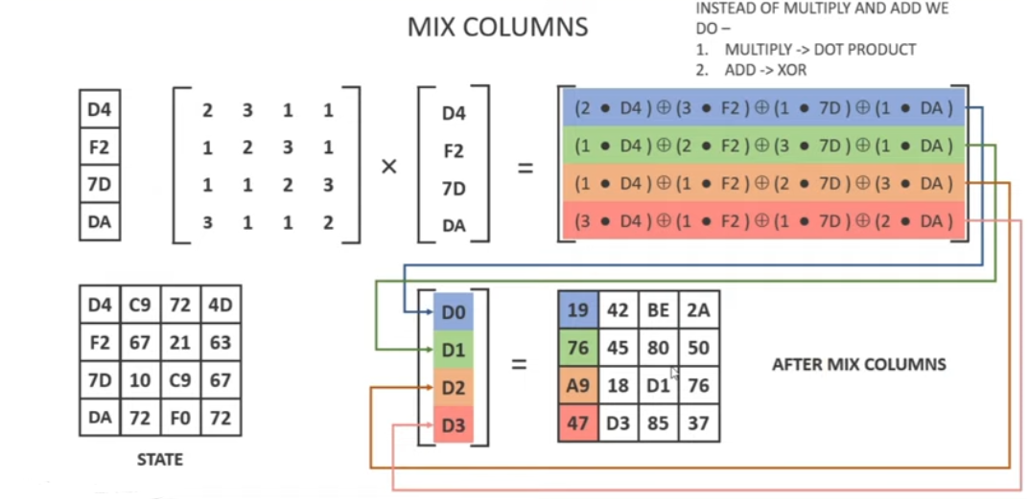
Round Steps: Mix Column

Slide 37
Round Steps: Mix Column
In general, dot product (instead of multiplying) of vectors of Galoi’s fields. This means multiplying corresponding Galoi’s field from the vectors and summing these products.
If product is bigger than a byte than we have to reduce with reduce polynomial.

Slide 38
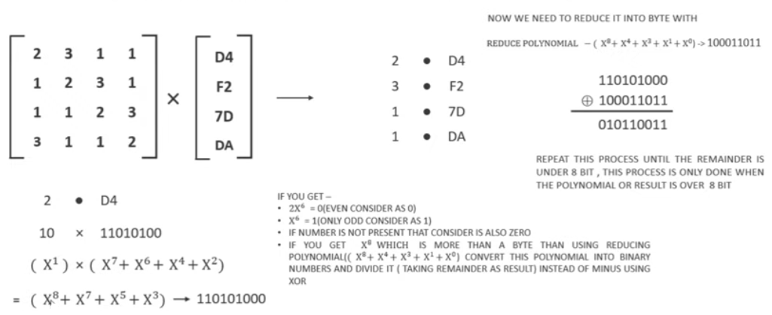
Round Steps: Mix Column (Reducing Polynomial)
Notes:
3X will considered as 1 but even number of X will be 0

Slide 39
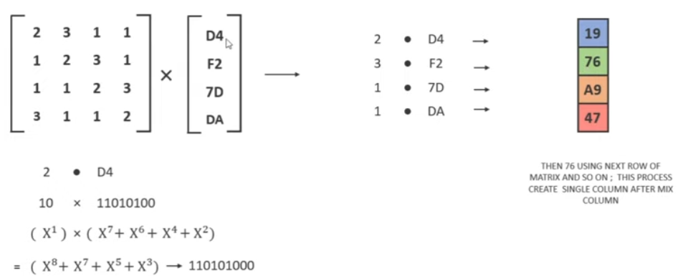
Round Steps: Mix Column (Reducing Polynomial)
Notes:
3X will considered as 1 but even number of X will be 0

Slide 40

ADVANCED ENCRYPTION STANDARD (AES)
Animation of AES working
Notes:
https://formaestudio.com/rijndaelinspector/archivos/Rijndael_Animation_v4_eng-html5.html

Slide 41
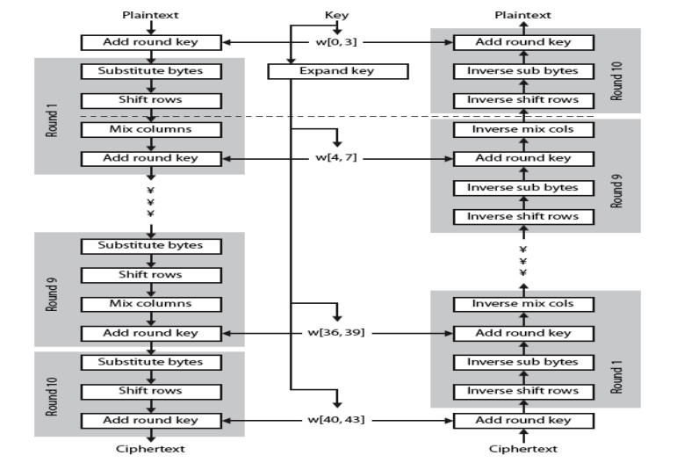
AES ENCRYPTION VS. DECRYPTION

Slide 42
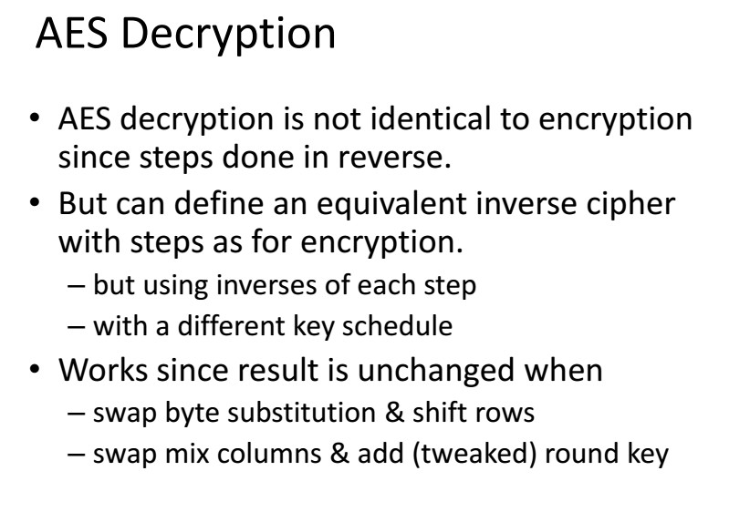
AES Decryption
Notes:
Tweaked (twisted)

Slide 43
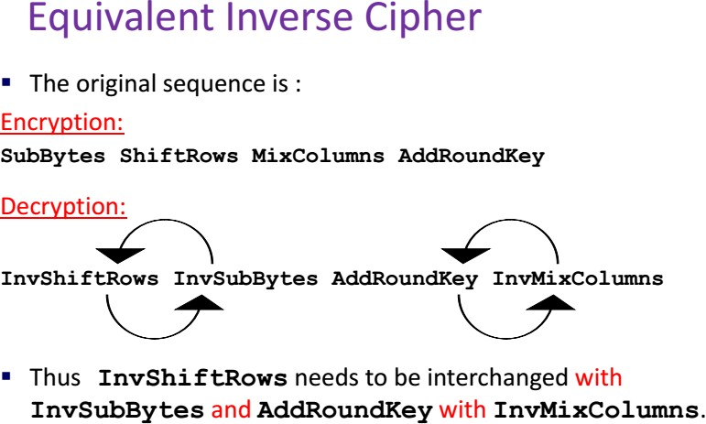
Equivalent Inverse Cipher

Slide 44
SOME KEY APPLICATIONS
RAR
Winzip
VPNs
IEEE 802.11e
Signal Protocol
  Facebook Messenger
  WhatsApp
Hopefully, you are now beginning to realize just how integral AES in running the entire framework of modern society.

Slide 45
STRENGTHS OF AES
As it is implemented in both hardware and software, it is most robust security protocol.
It uses higher length key sizes such as 128, 192 and 256 bits for encryption. Hence it makes AES algorithm more robust against hacking.
It is most common security protocol used for wide various of applications such as wireless communication, financial transactions, e-business, encrypted data storage etc.
It is one of the most spread commercial and open source solutions used all over the world.
For 128 bit, about 2¹²⁸ attempts are needed to break. This makes it very difficult to hack it as a result it is very safe protocol.

